Slide 1








Conceptual Architecture for Cummins Service System (CSS)
Multi-Channel
API
INSITE
Federated Sign-On
Siteminder
Create Work Order
Get Fault Codes
Get Solution Tree
Generate Quote
Seamless connectivity
Cummins Digital Hub
EDS

Slide 2


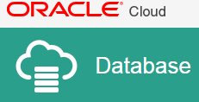







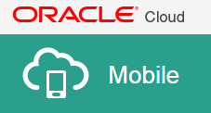




The Solution – Detailed Diagram
Siteminder
PUT
GET
PATCH
INSITE
Cummins Digital Hub
Expert Diagnostics

